Slide 1


#83102F
#16B8A8
#B61C49
#981743
#240212
#F3A902

Slide 2


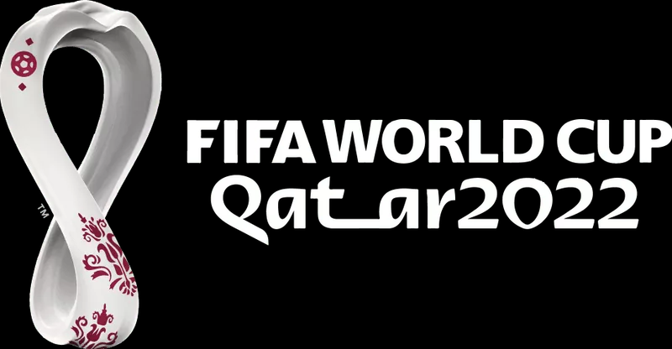




Slide 3


Slide 6
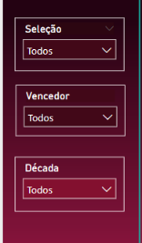



Slide 7
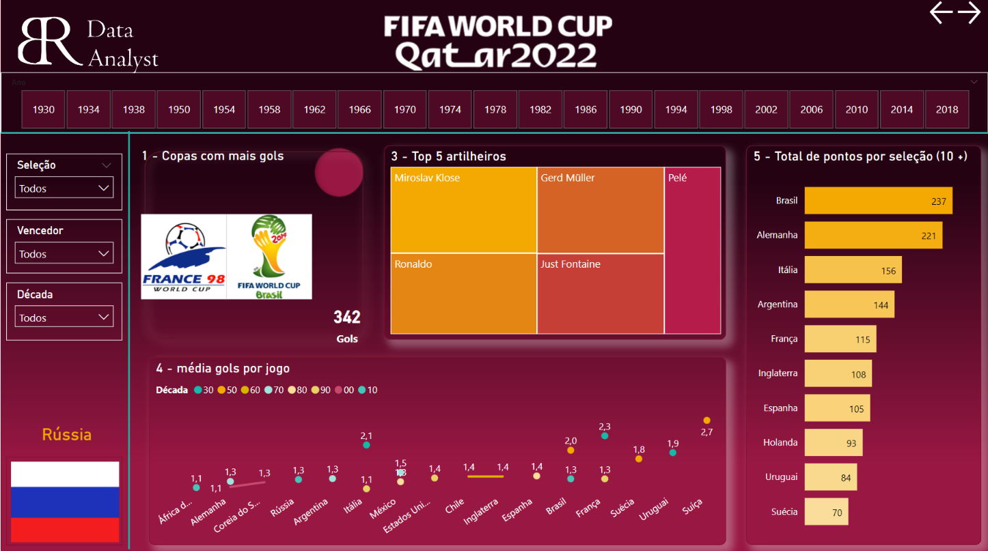

Slide 9


